Slide 1
Outage Probability and SER Calculation in Joint Relay and Antenna Selection for Full-Duplex AF Relay Networks
Rashmi Ravichandran (12BEC0595)
Project Guide: Prof. Rajesh R

Slide 2
Abstract
A joint relay and antenna selection scheme in general full-duplex (FD) relay networks with one source, one destination and N FD amplify-and-forward (AF) Relays is designed. Each FD relay is equipped with two antennas, one for receiving and one for transmitting. We consider a joint antenna and relay selection scheme to optimize the end-to-end error performance. Each relay adaptively selects the transmit antenna and receive antenna based on the instantaneous channel conditions, and the optimal single relay with the optimal Tx/Rx antenna configuration is selected to optimize the performance of the system transmission. This is in contrast to the conventional FD relay selection, where the Tx and Rx FD antenna of each relay are fixed. The proposed scheme achieves extra space diversity due to the antenna selection at the relay nodes, and improves the system performance compared to the conventional FD relay selection. Furthermore, closed-form expressions for the outage probability and average symbol error rate (SER) are derived. The results are verified by the computer simulations. Results show that the proposed scheme outperforms the conventional full-duplex relay selection scheme with fixed relay Tx and Rx antennas.

Slide 3
Introduction
Aim: To study the advantage of joint relay and antenna selection scheme
Full-duplex (FD) relay networks comprises of:
one source
one destination
N FD amplify-and-forward (AF) relays
FD relay is has two antennas, one for receiving and one for transmitting
WHY joint antenna and relay selection scheme ?
-> Optimizes System Performance
-> Decreases Error Rates

Slide 4
R
S
R
D
R

Slide 5
Each Relay selects which antenna to use as TX and RX
Relay selects the TX and RX antenna based on Channel Conditions
All the relays in the systems do this.
Out of N relays the best relay with optimal configuration to carry out end-to-end communication between the source and the destination is ultimately chosen for transmission.
Only this relay is active till the conclusion of the communication
This achieves Space Diversity and better System Performance

Slide 6
FD Relay Transmission: An Overview
At a relay Information is received and re-transmitted in the same frequency and time block (2 orthogonal channels in HD)
FD Relaying improves:
Throughput in Hot Spot Areas
Service in Edge of Cellular Region
FD Relaying effectively uses the channel BW but suffers from loop interference
Antenna Separation and Directional Antennas were suggested but, interference prevailed
Interference was modelled as additional noise in the receiver’s antenna and was solved through Signal Processing techniques.

Slide 7
Ultimately for Multiple Relay Systems – Relay Selection was employed to achieve required Space Diversity
Previous innovations incorporate ‘Hybrid Relaying’ – Which allows switching between HD and FD Relaying according to instantaneous channel conditions
But, Relay Transmitting and Receiving nodes are fixed and don’t change according to channel conditions
When channel suffers from excessive scattering and deep fading, system output is not optimal.

Slide 8
System Model
R1
H (S,i)
H (i,D)
S
Ri
D
Rn

Slide 9
Assuming ith relay node Ri receives and forwards the signal
Received Signal at Ri is defined as:
y_{i}[n] = h_{S,I} x[n] + h_{LI,I} x_{i}[n] + n_{i}[n]
h_{S,I} x[n] = Source-Relay Link
h_{LI,I} x_{i}[n] = Loop Interference between Relay Tx and Rx
n_{i}[n] = AWGN with σ²
‘n’th transmit signal of Source is considered

Slide 10

Re-transmit signal is given as:
x_{i}[n] = βy_{i} [n − τ ]
β = Power Amplification Factor
τ = Processing Delay
“Power Constraint” Equation:
E|x_{i}[n]|² = β²|h_{S,i}|²P_{t} + |h_{LI,i}|²P_{t} + σ² ≤ P_{t}
β can be derived as:
β = $√\frac{\text{P}\text{t}}{\text{|}\text{hS}\text{,}\text{i}\text{|}\text{2}\text{P}\text{t} \text{+ }\text{|}\text{hLI}\text{,}\text{i}\text{|}\text{2}\text{P}\text{t} \text{+ }\text{σ}\text{2} }$
Received signal at the destination is:
y_{D}[n] = h_{i,D}x_{i}[n] + n_{D}[n]
h_{i,D =} channel link from R_{i} to Destination
n_{D =} AWGN with power σ²

Slide 11

SINR ratio or γ can be defined mathematically as:
γ = $\frac{\text{y}\text{i}\text{[}\text{n}\text{]}}{\text{x}\text{i}\text{[}\text{n}\text{]}}$
Simplifying and inserting β this can be re-written as:
γ = $\frac{\text{|}\text{hS}\text{,}\text{i}\text{|}\text{2}\text{|}\text{hi}\text{,}\text{D}\text{|}\text{2} \text{β}\text{2}}{\text{|}\text{hi}\text{,}\text{D}\text{|}\text{2}\text{|}\text{hLI}\text{,}\text{i}\text{|}\text{2} \text{β}\text{2}\text{ + }\text{|}\text{h}\text{i}\text{,}\text{D}\text{|}\text{2} \text{β}\text{2} \text{σ}\text{2}\text{ + }\text{σ}\text{2}}$
γ = $\frac{\text{γ}\text{SR}\text{i}\text{γ}\text{R}\text{i}\text{D}}{\text{γ}\text{SR}\text{i} \text{+ (}\text{γ}\text{R}\text{i}\text{D} \text{+ 1)(}\text{γ}\text{R}\text{i} \text{+ 1)}}$
$\text{γ}\text{SR}\text{i}$= P_{t}|h_{S,i}|²/σ²
$\text{γ}\text{R}\text{i}\text{D}$ = P_{t}|h_{i,D}|²/σ²
$\text{γ}\text{R}\text{i}$= P_{t}|h_{LI,i}|²/σ²
These are the instantaneous channel SNR and can be modelled as exponential RV – λ because links remain stationary in a time slot and only vary, independently from one time slot to another

Slide 12
Antenna Selection Procedure
The Transmit antenna and Receive antenna for each relay are adaptively selected
Antenna Selection procedure is expressed mathematically as:
m_{i,AS} = arg max{γ_{i,T1→T2}, γ_{i,T2→T1}}
T1 and T2 are the antennas of the ith relay
γ_{i,T1→T2} = SINR when the ith relay node chooses the antenna T1 as the receive antenna and T2 as the transmit antenna
γ_{i,T2→T1} = SINR when the ith relay node chooses the antenna T2 as the receive antenna and T1 as the transmit antenna

Slide 13

Outage Probability
Probability of an outage occurring due to Rayleigh Fading is known as outage probability
General Outage Probability equation:
Pout(x) = [1- $\frac{2}{1+ ηx}I\left(x\right)+\frac{2}{1+2ηx}I2\left(x\right)$]^{N}
For N relay network
η is the loop interference level
I(x) = CDF of SINR
$I\left(x\right)=exp ⁡(−\frac{2x}{λ}$)$\frac{2\sqrt{x2+x}}{λ}$ K₁ $\frac{2\sqrt{x2+x}}{λ}$
X is taken as 3 arbitrarily
K is the first order modified Bessel Function

Slide 14
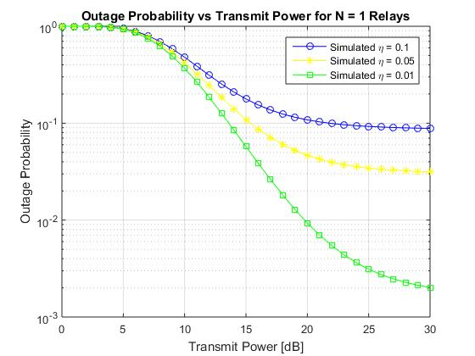

Slide 15
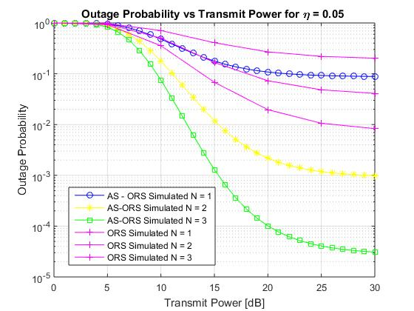

Slide 16

Symbol Error Rate (SER)
Determines the average amount of error bits which are likely to occur due to high SNR and Rayleigh Fading
$SER= \sum_{n=0}^{N}{\sum_{m=0}^{n}{\left({N \atop n}\right)}}\left({n \atop m}\right){−2}^{m}α$f_{n,m}
f_{n,m} = $\sum_{i=0}^{m}{\sum_{j=0}^{n−m}{\left({i \atop m}\right)}}\left({j \atop n−m}\right){(−2)}^{a−1}\sqrt{β}$η^{b}$\frac{\left(2b −1\right)‼}{{(β+2c)}^{(b+\frac{1}{2})}}$
Here:
BPSK Modulation : α = 1; β = 2
$$a=n −2m −i−j$$
$$b=2\left(n −i −j\right)$$
$$c=(\frac{10}{3}n −\frac{5}{3}m −\frac{2}{3i}−\frac{4}{3}j)η+ \frac{4n −2m}{λ}$$

Slide 17
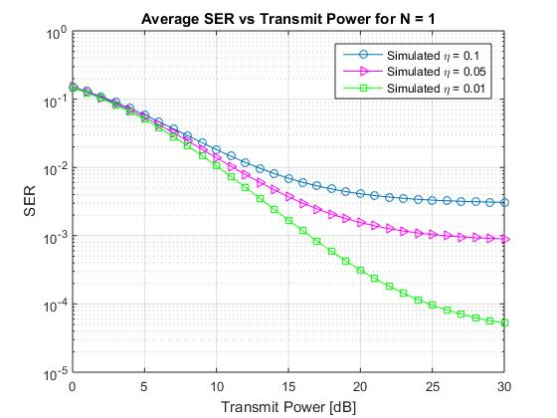

Slide 18
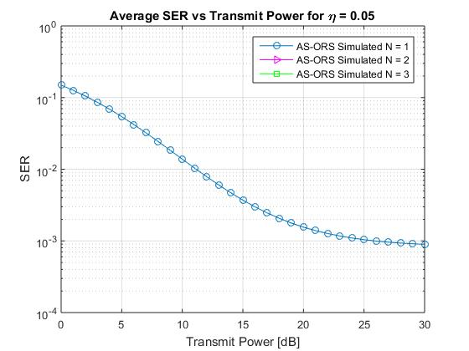

Slide 19
Further Work
Debug Code for SER and arrive at N = 2 and N = 3 curves for eta = 0.05
Obtain comparison curves of ORS for number of relays in SER
Incorporate an extra parameter to add to existing project

Slide 20
References
J.I. Choi, M. Jainy, K. Srinivasany, P. Levis, and S. Katti in “Achieving single channel, full duplex wireless communication,” In Proc. 2010 ACM MobiCom, pp. 1–12, 2010
Joint Relay and Antenna Selection for Full-Duplex AF Relay Networks, Proceedings of the 2014 IEEE International Conference on Communications (ICC 2014), vol.N/A, 2014, pp. 4454-4459
S.I. Kim, Y.C. Ko, and J. Heo, “Outage analysis of amplify-and-forward partial relay selection scheme with multiple interferers,” IEEE Commun.Lett., vol. 15, pp. 1281–1283, Dec 2011
M. Zhou, H. Cui, L. Song, and B. Jiao, “Transmit-receive antenna pair selection in full duplex systems,” IEEE Wireless Commun. Lett., pp. 1–4, Nov. 2013
I. Krikidis, H.A. Suraweera, P.J. Smith, and C. Yuen, “Full-duplex relay selection for amplify-and-forward cooperative networks,” IEEE Trans. Wireless Commun., vol. 11, no. 12, pp. 4381–4393, Dec. 2012

Slide 21
Thank You!

